Slide 1
Life Expectancy Prediction in India using Linear Regression
Aakash Yadav & Bhawani Singh
MCA-AIML-B1 | Applied Machine Learning Lab

Slide 2
Problem Statement & Objectives
- Predict life expectancy trends in India using health indicators
- Analyze infant & adult mortality trends
- Study their impact on life expectancy
- Build a regression model to evaluate relationships

Slide 3
Dataset Details
- Source: life.csv (Global health dataset)
- Attributes:
  Year,
  Life Expectancy,
  Infant Mortality,
  Adult Mortality
- Filtered: India-specific records
Focus Variables:
  Infant Mortality,
  Adult Mortality

Slide 4
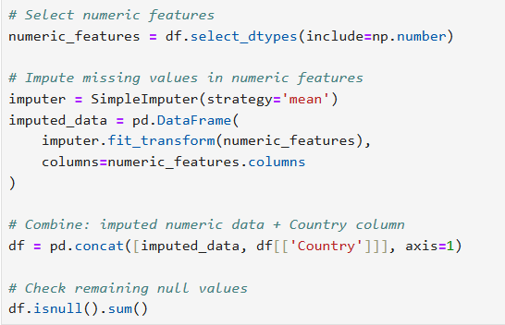
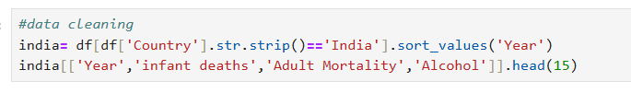
Data Preprocessing
- Handled missing values with mean imputation
- Selected numeric features
- Cleaned inconsistencies
- Filtered India-specific data

Slide 5
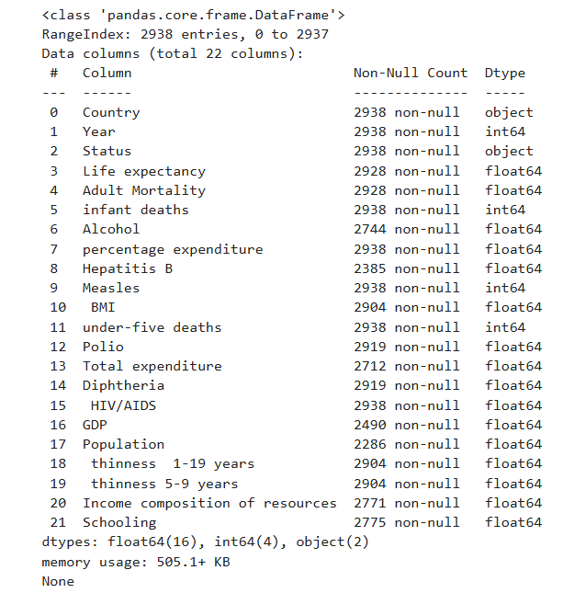
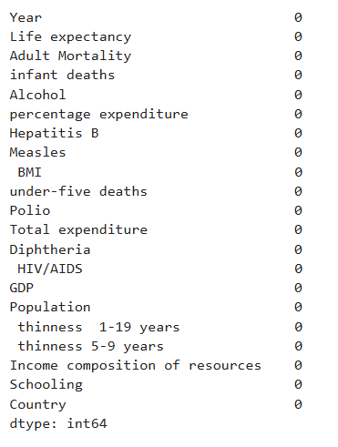
Data Preprocessing

Slide 6
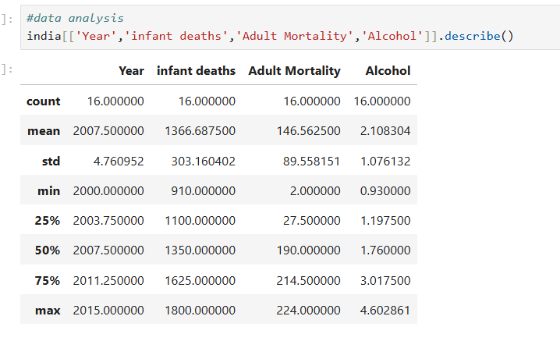
Data Preprocessing

Slide 7
Model Used
- Linear Regression (scikit-learn)
- Models:
• Infant Mortality vs Year
• Adult Mortality vs Year
- Tools: Python, Pandas, Matplotlib, scikit-learn

Slide 8
Evaluation Metrics
- Mean Squared Error (MSE)
- Mean Absolute Error (MAE)
- R² Score (Coefficient of Determination)

Slide 9
Results
• Infant Mortality (India & Russia):
- Strong downward trend
- R² ≈ 0.99 (excellent fit)
• Adult Mortality (India):
- Data irregular, poor model fit
- Negative R² (unreliable model)

Slide 10
Challenges & Solutions
- Challenge: Missing & inconsistent data
  • Solution: Mean imputation & filtering
- Challenge: Adult mortality unpredictable
  • Solution: Future scope → Non-linear models

Slide 11
Demo Screenshots
- Scatter plots of mortality trends
- Regression line predictions
- Training vs Testing data visualizations

Slide 12
Conclusion
- Infant mortality reduction drives higher life expectancy
- Adult mortality harder to model with linear regression
- Life expectancy reflects India’s healthcare improvements

